Slide 1
Transaction processing

Slide 2
Transaction
The transaction is a set of logically related operation. It contains a group of tasks.
A transaction is an action or series of actions. It is performed by a single user to perform operations for accessing the contents of the database.
(Transaction is set of instruction. Transaction is also process but it must always in atomic nature either work/execute or not)

Slide 3
Example:
Suppose an employee of bank transfers Rs 800 from X's account to Y's account. This small transaction contains several low-level tasks:
X's Account
Open_Account(X)
Old_Balance = X.balance
New_Balance = Old_Balance - 800
X.balance = New_Balance
Close_Account(X)
Y's Account
Open_Account(Y)
Old_Balance = Y.balance
New_Balance = Old_Balance + 800Y.balance = New_Balance
Close_Account(Y)

Slide 4
Transaction property
The transaction has the four properties. These are used to maintain consistency in a database, before and after the transaction.
Property of Transaction
Atomicity
Consistency
Isolation
Durability

Slide 5
Why Important?
What we want?
We want to maintain consistent database to maintain consistency of database. Instead of working on database we work on what are the process that interact with database. If the database is consistent then no need to apply any process on the database.
DB
T

Slide 6
Transaction is a logic or unit which interact with database.
If database is consistent and transaction is only way to interact with database then, instead of concentrate on database we focus on transaction. And if transaction works well then our database is always in consistent state.
Reason we study ACID property if transaction satisfied those ACID property then it will maintain your DB consistent.

Slide 7
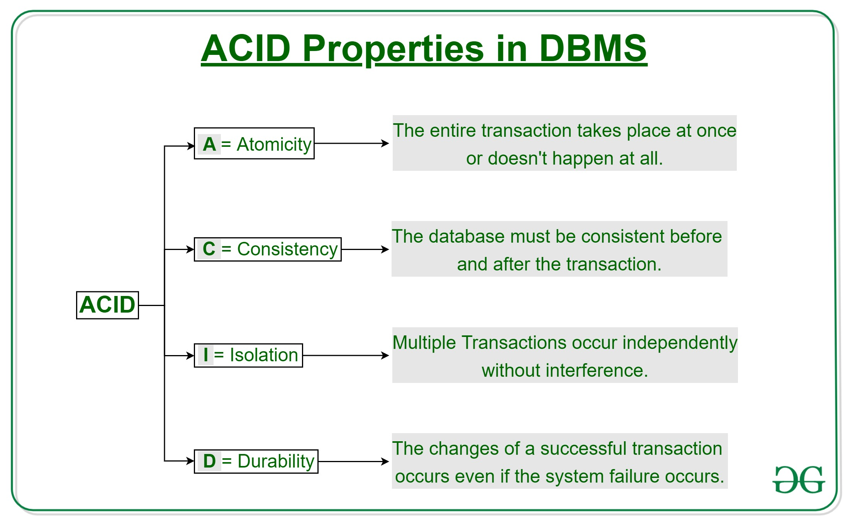

Slide 8
1. Atomicity
Transaction should in atomic nature.
Either all the instruction participating in transaction must execute or none of them is execute.

Slide 9
Example:
Let's assume that following transaction T consisting of T1 and T2. A consists of Rs 600 and B consists of Rs 300. Transfer Rs 100 from account A to account B.
After completion of the transaction, A consists of Rs 500 and B consists of Rs 400.
If the transaction T fails after the completion of transaction T1 but before completion of transaction T2, then the amount will be deducted from A but not added to B. This shows the inconsistent database state. In order to ensure correctness of database state, the transaction must be executed in entirety.
T1 | T2
Read(A) A:= A-100 Write(A) | Read(B) Y:= Y+100 Write(B)

Slide 10
2. Isolation
Isolation property of a transaction means that the data used during the execution of a transaction cannot be used by a second transaction until the first one is completed.
• This property isolates transactions from one another.
• In other words, if a transaction T1 is being executed and is using the data item X, that data item cannot be accessed by any other transaction (T2………..Tn) until T1 ends.
• The isolation property is enforced by the concurrency control subsystem of the DBMS.

Slide 11
There should be a logical isolation
T1, T2
We can say that this transaction is in isolation if not affected by each other.
Eg. Suppose, I go to restaurant no one is there in the restaurant and I order something and I get my order. On next day I go to restaurant and there are also some other people and I order something and I get my order so, is that matter that other person is there or not.
No, because if T1 execute total alone and T1 execute with multiple context switching with other transaction then t1 is in isolation

Slide 12
3.Durability
• The durability property of transaction indicates the performance of the database's consistent state.
• It states that the changes made by a transaction are permanent.
• They cannot be lost by either a system failure or by the erroneous operation of a faulty transaction. When a transaction is completed, the database reaches a consistent state and that state cannot be lost, even in the event of system's failure.
• Durability property is the responsibility of the recovery subsystem of the DBMS.

Slide 13
Eg.
i=4
Increment the value +1 so, i=5
Value is updated and this value is store in the system respect of hardware or software failure
What ever changes you have done in the data or system that changes must precise in the system.

Slide 14
4.Consistency
• Database consistency is the property that every transaction sees a consistent database instance.
• In other words, execution of a transaction must leave a database in either its prior stable state or a new stable state that reflects the new modifications (updates) made by the transaction.
• If the transaction fails, the database must be returned to the state it was in prior to the execution of the failed transaction. If the transaction commits, the database must reflect the new changes. Thus, all resources are always in a consistent state.

Slide 15
Eg.
There was a DB it was in consistent state and you process it some transaction T1 and it has updated your data in to new state.
What consistency say if DB is consistent before transaction then it is also remain consistent after transaction.
If Atomicity, Consistency, Isolation, Durability holds good then automatically DB is Consistent.

Slide 16
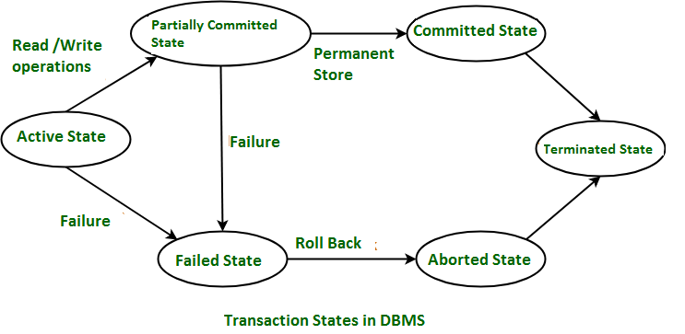
States of Transaction

Slide 17
Active State – When the instructions of the transaction are running then the transaction is in active state. If all the ‘read and write’ operations are performed without any error then it goes to the “partially committed state”; if any instruction fails, it goes to the “failed state”.
Partially Committed – After completion of all the read and write operation the changes are made in main memory or local buffer. If the changes are made permanent on the Data Base then the state will change to “committed state” and in case of failure it will go to the “failed state”.

Slide 18
Failed State – When any instruction of the transaction fails, it goes to the “failed state” or if failure occurs in making a permanent change of data on Data Base.
Aborted State – After having any type of failure the transaction goes from “failed state” to “aborted state” and since in previous states, the changes are only made to local buffer or main memory and hence these changes are deleted or rolled-back.

Slide 19
Committed State – It is the state when the changes are made permanent on the Data Base and the transaction is complete and therefore terminated in the “terminated state”.
Terminated State – If there isn’t any roll-back or the transaction comes from the “committed state”, then the system is consistent and ready for new transaction and the old transaction is terminated.

Slide 20
Concurrency Problems
When multiple transactions execute concurrently in an uncontrolled or unrestricted manner, then it might lead to several problems. These problems are commonly referred to as concurrency problems in database environment. The four concurrency problems that can occur in database are:
1. Dirty Read Problem
2. Unrepeatable Read Problem
3. Phantom Read Problem
4. Lost Update Problem

Slide 21
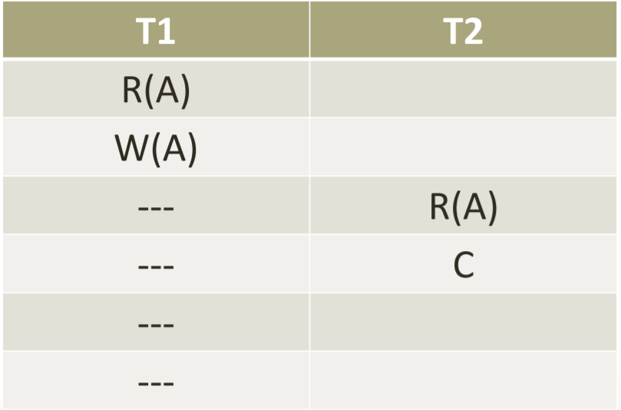
Dirty Read Problem
When a transaction read a value of some uncommitted transaction then it is called DRP.

Slide 22
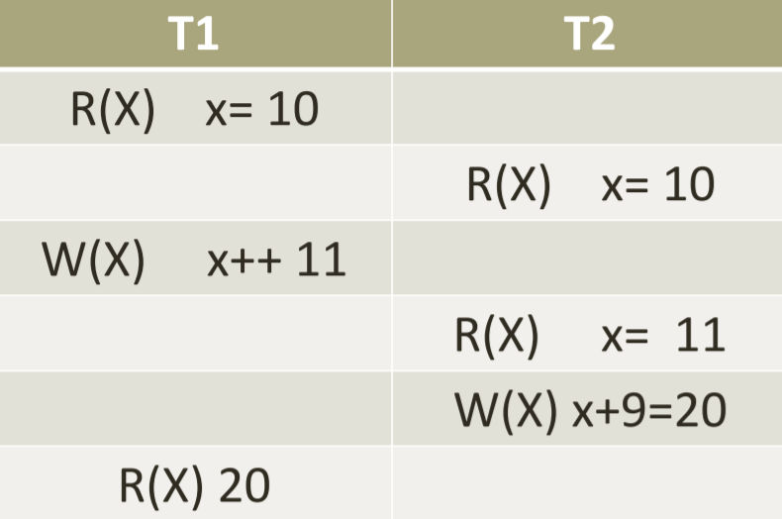
Unrepeatable Read Problem
When same value is read multiple times by a transaction and each time read operation get a different value (Because of change by some other transaction).

Slide 23
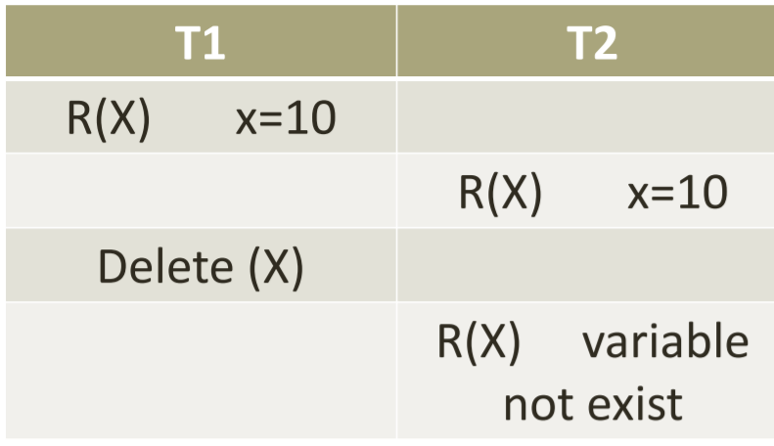
Phantom Read Problem
When transaction trying to read a value which is deleted by another transaction.

Slide 24
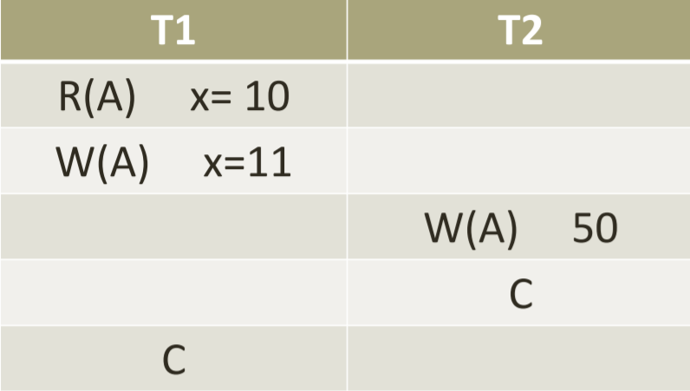
Lost Update
When a transaction write a value before reading it.

Slide 25
DBMS Schedule
We know that transactions are set of instructions and these instructions perform operations on database. When multiple transactions are running concurrently then there needs to be a sequence in which the operations are performed because at a time only one operation can be performed on the database. This sequence of operations is known as Schedule.
• Lets take an example to understand what is a schedule in DBMS.
• DBMS Schedule example
• The following sequence of operations is a schedule. Here we have two transactions T1 & T2 which are running concurrently.
• This schedule determines the exact order of operations that are going to be performed on database. In this example, all the instructions of transaction T1 are executed before the instructions of transaction T2, however this is not always necessary and we can have various types of schedules.

Slide 26
T₁ | T₂
R(A)
W(A)
R(B)
 | W(B)
 | R(A)
 | R(B)

Slide 27
Serial Schedule
In Serial schedule, a transaction is executed completely before starting the execution of another transaction. In other words, you can say that in serial schedule, a transaction does not start execution until the currently running transaction finished execution. This type of execution of transaction is also known as non-interleaved execution. The example we have seen above is the serial schedule.
Lets take another example.
Serial Schedule example Here R refers to the read operation and W refers to the write operation. In this example, the transaction T2 does not start execution until the transaction T1 is finished.

Slide 28
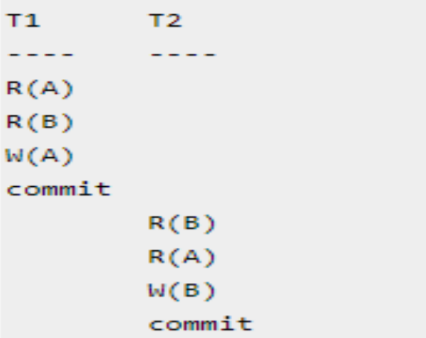

Slide 29
Non- Serial schedule
This is a type of Scheduling where the operations of multiple transactions are interleaved. This might lead to a rise in the concurrency problem. The transactions are executed in a non-serial manner, keeping the end result correct and same as the serial schedule. Unlike the serial schedule where one transaction must wait for another to complete all its operation, in the non-serial schedule, the other transaction proceeds without waiting for the previous transaction to complete. This sort of schedule does not provide any benefit of the concurrent transaction. It can be of two types namely, Serializable and Non-Serializable Schedule. The Non-Serial Schedule can be divided further into Serializable and Non-Serializable.

Slide 30
T₁ | T₂
R(A)
W(A)
 | R(B)
 | W(B)
R(A)
 | R(A)
W(B)
 | W(A)

